Slide 1





Geospatial Operations in R
Learn how to use R as GIS and incorporate geospatial operations into your R workflows
Matt Shank
Bureau of Clean Water
March 27, 2025
JOSH SHAPIRO, GOVERNOR | JESSICA SHIRLEY, ACTING SECRETARY

Slide 2

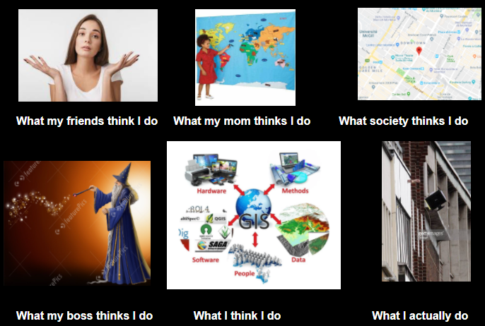
Outline
Introduction
R background and capabilities
Importance of projects
Keyboard shortcuts
Piping and tidycoding principles
Overall utility of geospatial workflows in R
Background on the example – acidification in PA
Module 1: Importing/accessing geospatial data in R
Module 2: Geospatial Operations
Module 3: Exporting spatial objects
Module 4: Map creation

Slide 3
Introduction
What is R?
R is a language and environment for statistical computing and graphics.
The R environment
R is an integrated suite of software facilities for data manipulation, calculation and graphical display. It includes:
an effective data handling and storage facility,
a suite of operators for calculations on arrays, in particular matrices,
a large, coherent, integrated collection of intermediate tools for data analysis,
graphical facilities for data analysis and display either on-screen or on hardcopy, and
a well-developed, simple and effective programming language which includes conditionals, loops, user-defined recursive functions and input and output facilities.
TLDR: R can handle your database querying, data wrangling, cleaning, statistical, reporting, and geospatial problems!
Source: https://www.r-project.org/about.html

Slide 4
Introduction
Why use R?
automation: repeat tasks avoiding boredom and mistakes
flexibility: tweak analyses or create new ones
incredible functionality
reproducibility!

Slide 5
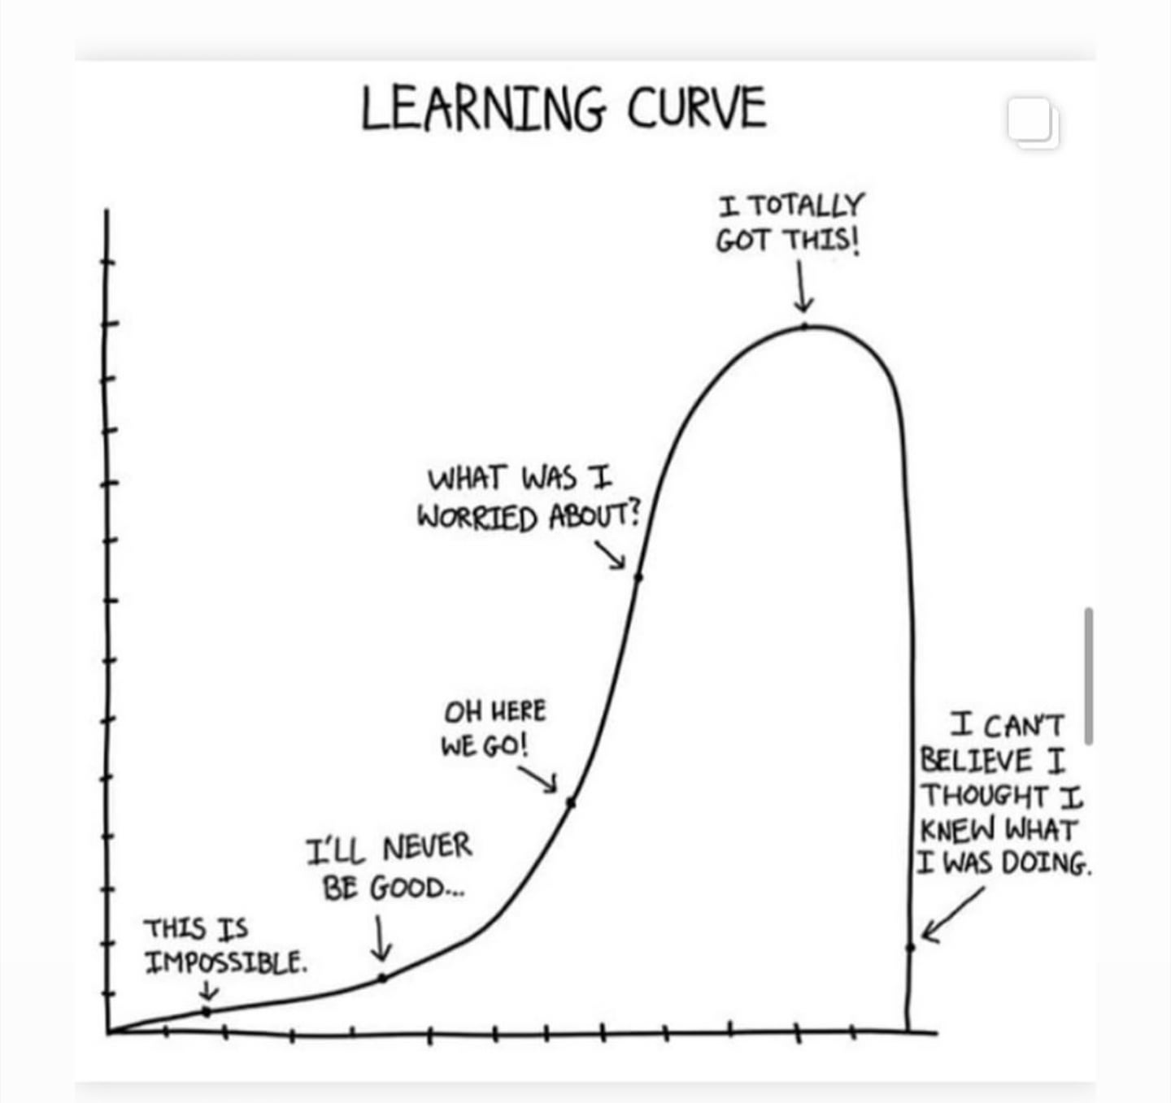
Introduction
First, teaching R is often confounded with teaching statistics. Pick one (preferably R first), and then move on to the other.
- I’m teaching both geospatial techniques and R in four hours today (sorry)
Second, start by only teaching the most essential and important functions first. Don’t overwhelm your students with all the functions they might ever need to know. And if you know two ways to do the same thing? Just pick one.
- tried to strike a balance here, focusing on only the most commonly used sf functions, wrapping it into a tangible example workflow
Source: https://www.r-bloggers.com/2021/07/the-myth-of-the-r-learning-curve/

Slide 6



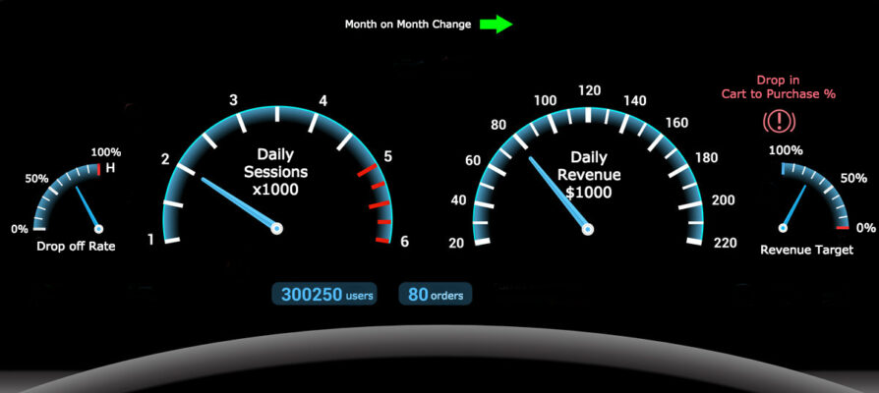
Introduction
R Studio is the dashboard, plus
bells, whistles, etc…
R is the engine

Slide 7
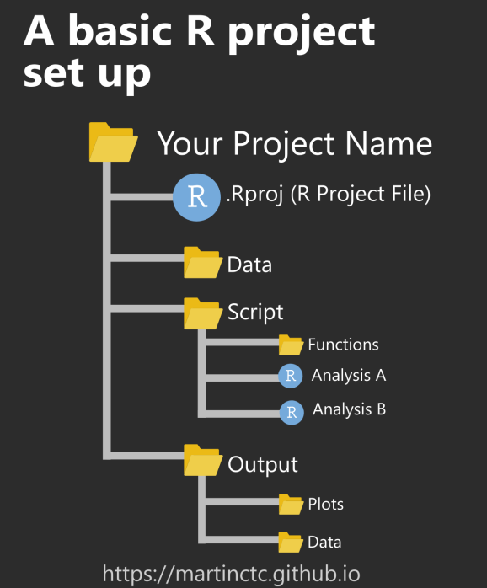
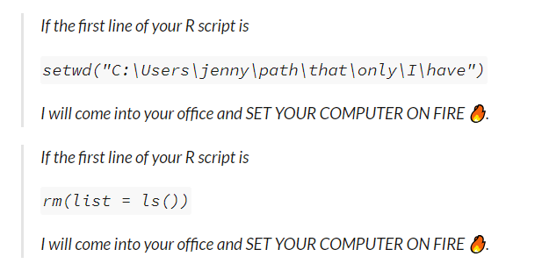
Introduction
First some ground rules
Create a project
Recommended reading:
https://r4ds.had.co.nz/workflow-projects.html ;
https://www.tidyverse.org/blog/2017/12/workflow-vs-script/

Slide 8
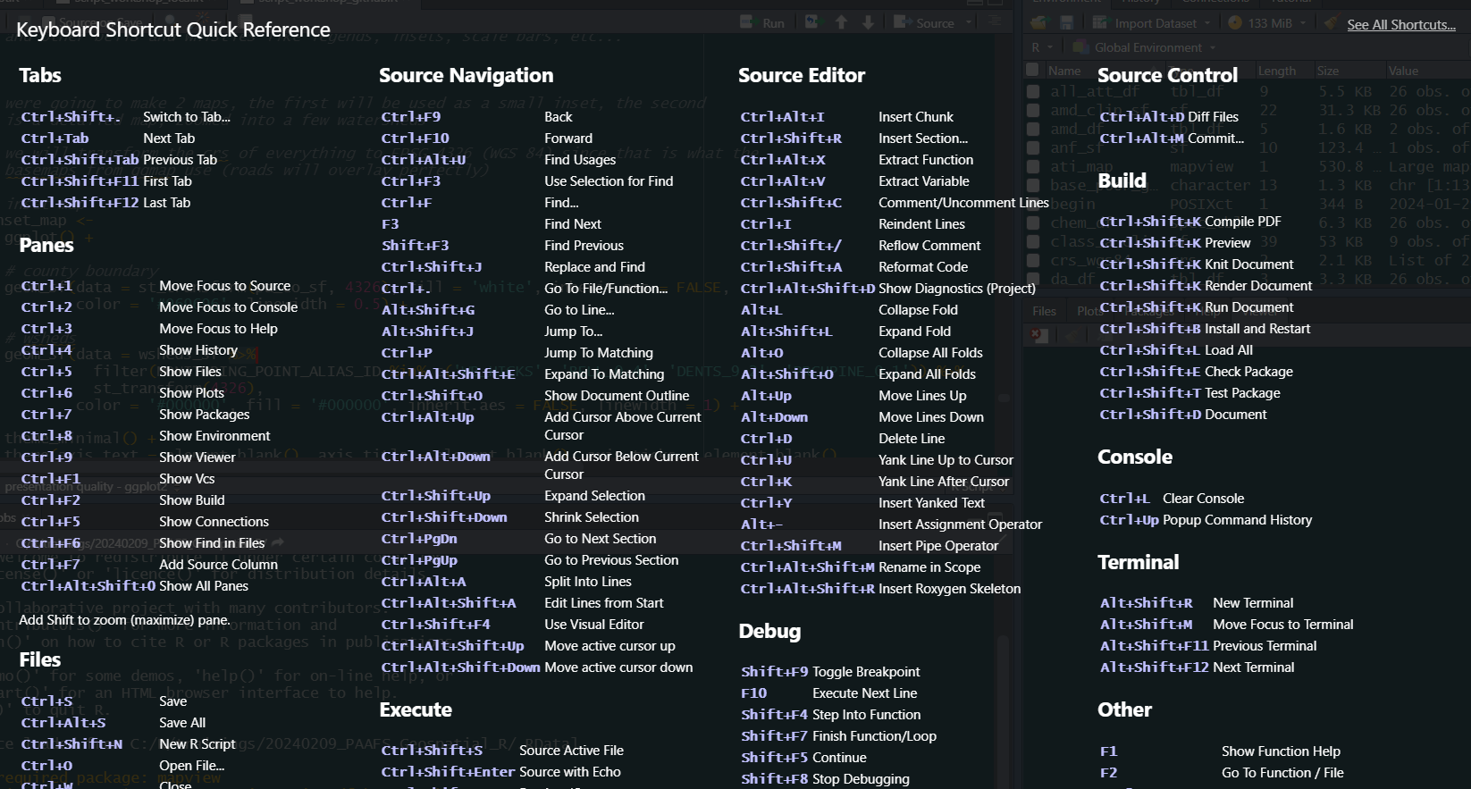
Introduction
First some ground rules
Learn your keyboards shortcuts.
Do you know how annoying it is to type <- or %>% ???
Tools → Keyboard Shortcuts Help
Alt + - = <-
Ctrl + shift + m = %>%
Ctrl + shift + c = #
Ctrl + I = indent
Ctrl + c = COPY
Ctrl + v = PASTE
Ctrl + shift + r = new section

Slide 9
Introduction
First some ground rules
Today we will follow tidy coding principles
Our code will be human centered, consistent, composable, and inclusive
solve complex problems by breaking them down into small pieces, supporting a rapid cycle of exploratory iteration to find the best solution.
first _df %>% # start with a data frame
left_join(other_stuff_df, by = “shared_col”) %>% # join other stuff
select(-dumb_col) %>% # drop dumb column
mutate(new_col = number_col * 18.265) # multiply existing column by a constant

Slide 10
Introduction
Spatial data formats in R
vector formats (points, lines, polygons)
'SpatialPoints', 'SpatialLines', 'SpatialPolygons’ (sp package) -- obsolete
'simple features' (sf package)
'SpatVector' (terra package)
raster formats (pixel images)
'raster' (raster package) -- obsolete
'stars' (stars package)
'SpatRaster' (terra package)
We will use sf for vector formats
and terra for raster formats

Slide 11

Introduction
Overall utility of geospatial workflows in R
Unite data wrangling and statistical analysis capabilities with powerful geospatial functions

Slide 12
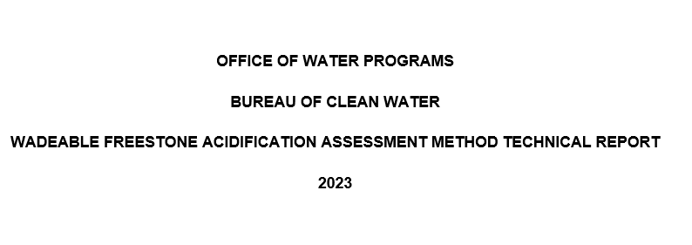
Acidification Example
PADEP just developed a draft acidification assessment method
This method documented relationships between surface water acidification (low pH) and geology, roads, and AMD
The method also created a new macroinvertebrate metric, the Acid Tolerance Index (ATI), which is responsive to stream pH
Core concepts
‘Base-poor’ geology formations
The higher % base-poor geology in a watershed, the lower the stream pH
The lower the stream pH, the higher the macroinvertebrate ATI score
High road density can increase pH
AMD can lower pH
Link to technical report

Slide 13
Acidification Example
Today we will bring in 26 watersheds from the acidification study in the four counties surrounding the Allegheny National Forest
Access data from github, REST services (PADEP, PASDA)
Make tabular data with lat & long spatial object (geometry column)
Clip geology, streams, roads, AMD discharges to watersheds
Buffer streams, dissolve geometry, clip roads again
Calculate statistics (length, area, density, ratios)
Plot tabular geospatial output against pH and ATI scores
Create a presentation quality static map, and a stand-alone interactive map
And some other stuff….

Slide 14
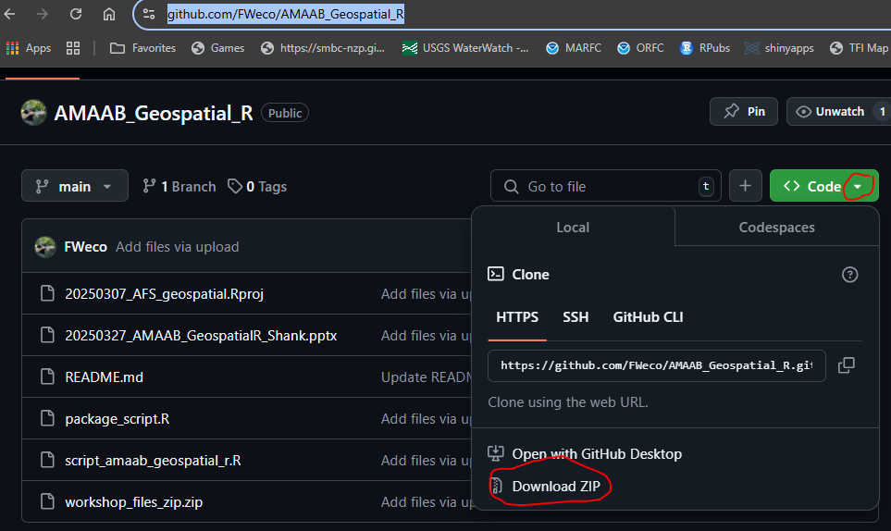
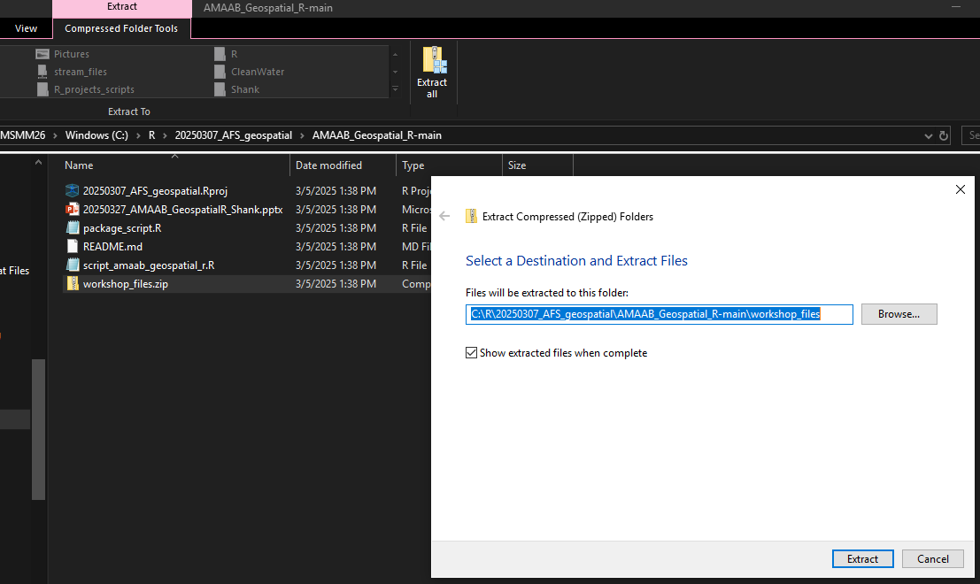
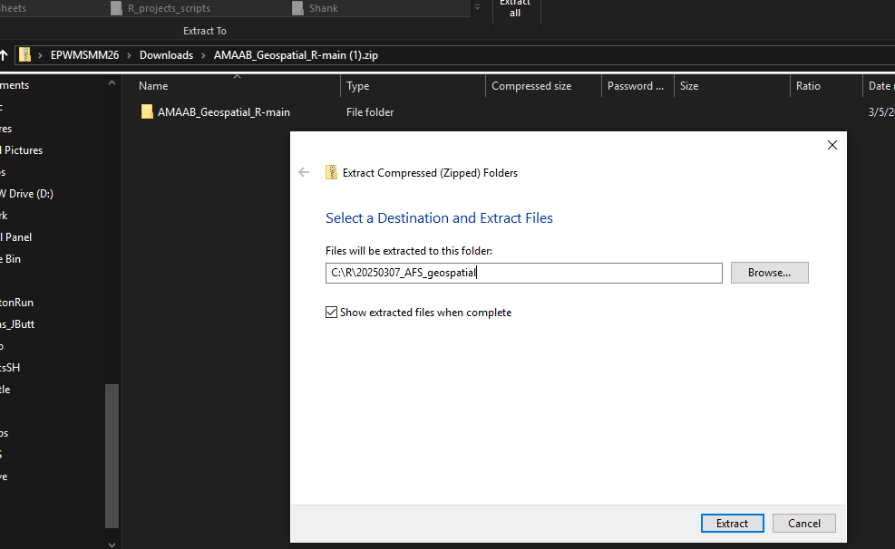
Configure Project; Download data from github
Navigate to your preferred directory location
Create a new folder (call it ‘20250307_AFS_geospatial’)
Navigate to https://github.com/FWeco/AMAAB_Geospatial_R
Click Code -> Download Zip
Extract to your 20250307_AFS_geospatial folder!
Extract workshop_files.zip to same folder!
3.
5.
4.

Slide 15
Module 1 - Importing
Importing/accessing geospatial data in R
Import various formats
.rds, .shp, .gpkg, tabular (x,y) - covered
Various spatial objects
Vector - Points, lines, polygons - covered
Raster – elevation - covered
From various sources
Online REST services (e.g. PASDA, PADEP)
Local or network directories/GIS geodatabases
R-ArcGIS Bridge – not covered (but amazing)
Set up tutorial
Checking and transforming coordinate reference system (crs)

Slide 16
Module 1 - Importing
R-ArcGIS Bridge (not covered)
A couple notes:
Allows you to access ESRI GIS resources as long as you have a valid ESRI license
Can write directly to your .gdb from R
Install the arc bridge
Useful vignette
Get started:
install.packages("arcgisbinding", repos="https://r.esri.com", type="win.binary")
library(arcgisbinding)
arc.check_product()
* Not covered today, but highly recommended

Slide 17
Module 1 - Importing
Online REST services (covered)
Representational state transfer
API (application programming interface) that helps you communicate with the information source
TONS of geospatial resources available
PASDA REST services tutorial:
https://rpubs.com/mattshank20/pasda_api
Local/network geospatial data in various formats (covered)¹
Local/network tabular data in various formats (covered)¹
¹Our data will be sourced from github for ease of access

Slide 18
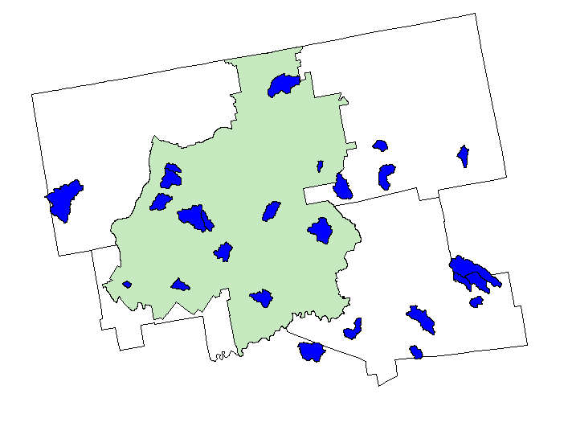
Module 1 - Importing
We’ll run Module 1 code together
Make special note of annotations in code
When we’re done you’ll successfully make this map
What

Slide 19
Module 2 – Geospatial operations
After we have imported our geospatial and tabular data, we can begin
Geospatial operations:
clip, buffer, dissolve, spatial selection, spatial join (covered)
Calculate statistics:
length, area, density, ratios

Slide 20
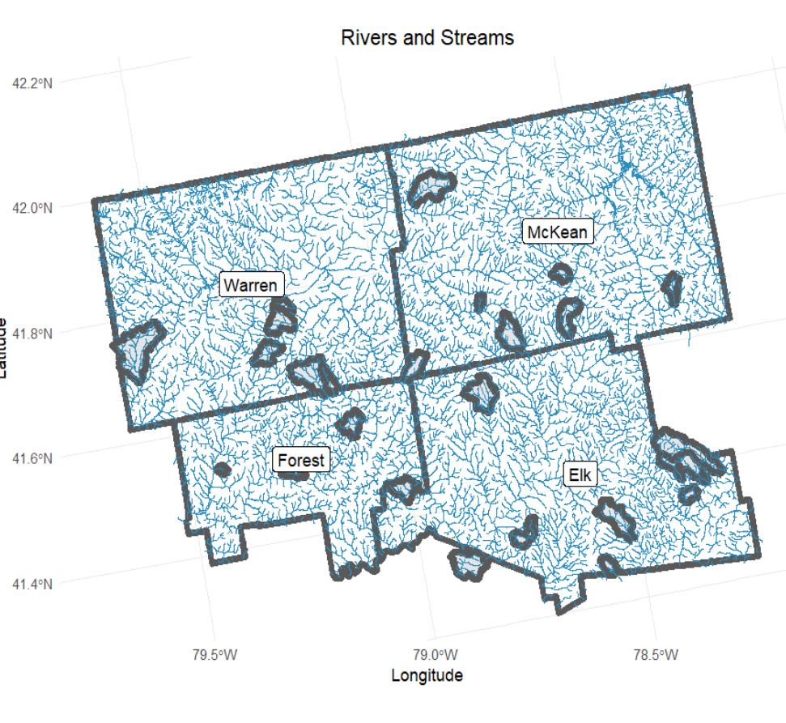
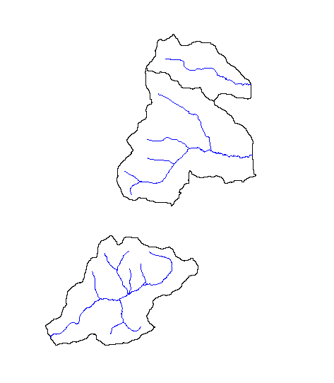
Module 2 – Geospatial operations
Run Module 2 code
Clip

Slide 21
Module 3 - Exporting
Can save to any preferred file format:
.rds, .rda, .shp, .gpkg¹
In one step, can project tabular (x,y | lat,long) data and export to .shp!
¹.gpkg – compact and open-source, can have multiple layers

Slide 22



Module 4 - Map creation
Static
Base plots (what?)
ggplot (Okay!)
Interactive
mapview() – html (YEEAAHH!)
For detailed training on interactive maps with leaflet, see the 2021 PA AFS workshop
Interactive Mapping in R: Don't get caught up in the static
https://rpubs.com/mattshank20/intMappingR

Slide 23

Wrap Up
Takeaways
Between your agency/school/institution's ESRI resources and REST services from places like PASDA and PADEP, there is a mountain of geospatial data available to you right now
Importing / analyzing / exporting / and map creation is simple
This removes the need for ‘intermediate steps’ in workflows
OLD: pull tabular data from database to excel, export to GIS for geospatial analysis, reimport to R for statistical modeling
NEW: pull data from database with R (ODBC, DBI, dbplyr), geospatial analysis in R, model in R
The ‘ideal world’ of workflows

Slide 24

Wrap Up
Takeaways
Keep st_zm() and st_make_valid() at the ready if you run into errors with invalid geometry
after you do something, plot it to give it a quick look
Run your code a chunk at a time to evaluate each step
Clean up your environment. If you don't need something again, DECLUTTER

Slide 25

Wrap Up
TONS of geospatial data available online
Natural Earth: http://www.naturalearthdata.com
USGS: https://earthexplorer.usgs.gov
NASA: https://sedac.ciesin.columbia.edu
Open Topography: https://opentopography.org
FAO: http://www.fao.org/geonetwork/srv/en/main.home
Free GIS data: https://freegisdata.rtwilson.com
… and many more! Search online for what you're after
TONS of geospatial data available from R packages
geodata: https://github.com/rspatial/geodata
rnaturalearth: https://cran.r-project.org/web/packages/rnaturalearth/vignettes/rnaturalearth.html
geodata: https://github.com/rspatial/geodata
… and many more! Search online for what you're after
It’s time to shuck()

Slide 26
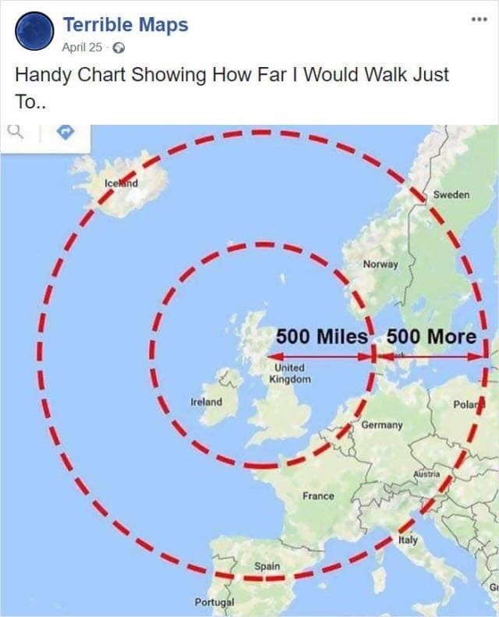

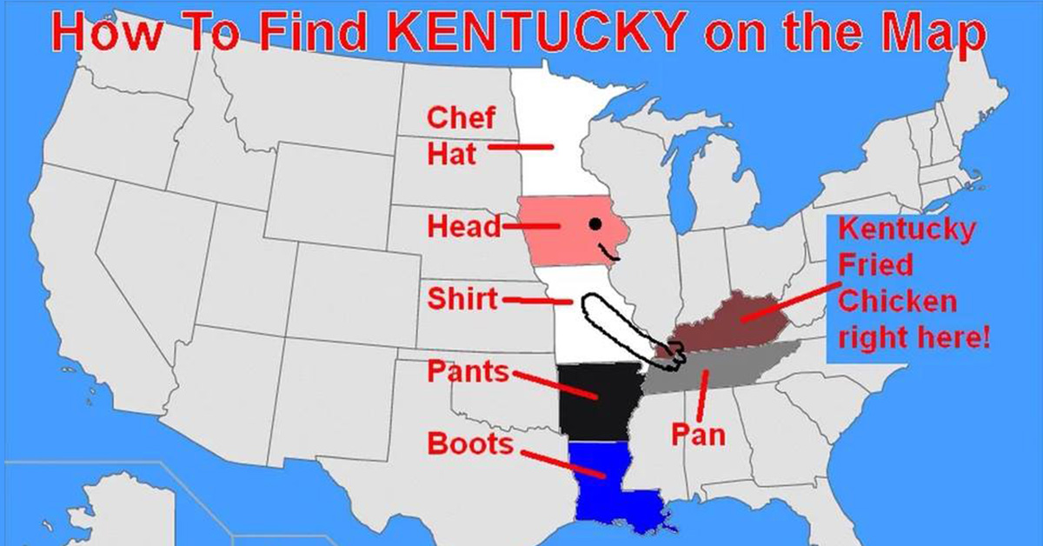
Wrap Up
Takeaways
Interactive maps are one of my favorite things in the world. You can communicate very complex dynamics very clearly by sharing a well made map
Static maps also have their place. And with a few rounds of trial and error (and attention to detail), ggplot makes some fine maps

Slide 27

Acknowledgments
R code troubleshooting
Dustin Shull, Ty Wagner, Becky Whiteash, Mark Hoger, Emma Jones
Questions/send me your cool R code: mattheshan@pa.gov
The Department of Environmental Protection’s mission is to protect Pennsylvania’s air, land and water resources and to provide for the health and safety of its residents and visitors, consistent with the rights and duties established under the Environmental Rights Amendment (Article 1, Section 27 of the Pennsylvania Constitution).
Miners Run – a beautiful acidified stream

